Slide 1

DeepD(r)iveDucks
Deep Learning in Practice
VITMAV45
Holló Áron
Tóth Tibor Áron
Hajnal Bálint

Slide 2

topics
1. Introduction, Goals, motivation
2. Duckietown, Previous solutions
3. DAgger algorithm
4. Network Architecture
5. Training
6. Problems
7. Results
8. Conclusion

Slide 3
Introduction, Goals, motivation
Using the Duckietown environment for a self-driving car
Improve an imitation learning algorithm: DAgger
Motivation: 2 of us learns autonomous vehicle control engineering

Slide 4
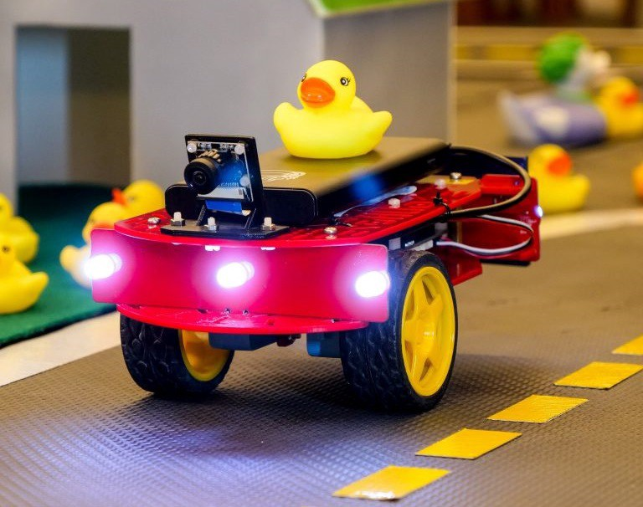
Duckietown, Previous solutions
Duckietown: platform to study MI and AI for self-driving cars
Several implementation methods for the challenges
DAgger: in 2011 for helping visually impared people crossing intersections

Slide 5
dagger algorithm
Our implemenation: Refining the DAgger baseline for lane keeping with hyperparameter optimization
Imitation learning – uses an expert solution to reward the agent
Problem: training data distribution
Solution: DAgger algorithm – the expert takes over control randomly to help recovery

Slide 6
Network Architecture
Convolution
3x3
Batch normalization 2D
ReLu
Convolution
3x3
Batch normalization 2D
BasicBlock modules:
Image input 120x160
Normalization: RGB → HSV
Convolution 3@32x32,f:5x5,s:2x2
MaxPool2D 3x3,s:2x2
BatchNorm2D 32
ReLU
BasicBlock
BatchNorm2D 32
ReLU
BasicBlock
BatchNorm2D 64
ReLU
BasicBlock
Flatten
ReLU

Slide 7
Training
implemented a grid search hyperparameter optimization
episode number | 10 | 15 | - | -
horizon | 64 | 128 | 256 | -
learning rate | 1e-1 | 1e-2 | 1e-3 | 1e-4
learning rate decay | 0.5 | 0.6 | 0.7 | 0.8
batch size | 16 | 32 | - | -
hyperparameter space
(space size = 2*3*4*4*2 = 192)

Slide 8
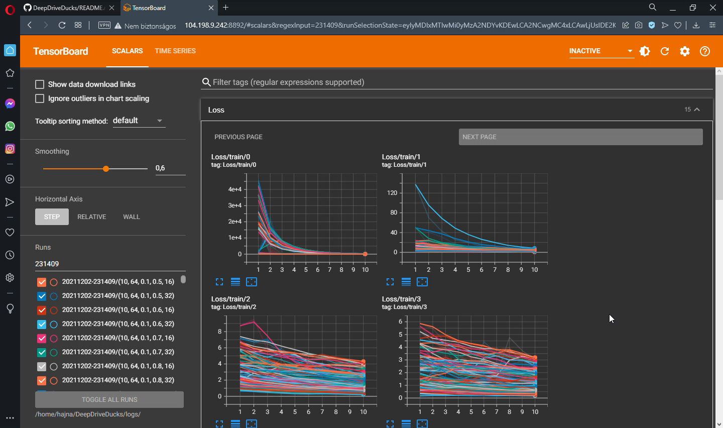
logging with tensorboard

Slide 9
Problems and challenges
Making baseline algorithm work in our environment
Hyperparameter optimisation for custom written baseline code
Establish
google cloud VM
version control system (github)
docker image to dockerhub
jupyter lab
tensorboard
More efficiently structured logging
delete saving huge data files to RAM after use
subfolders for organizing
Derive metric for optimization
average loss of last epochs among all episodes

Slide 10
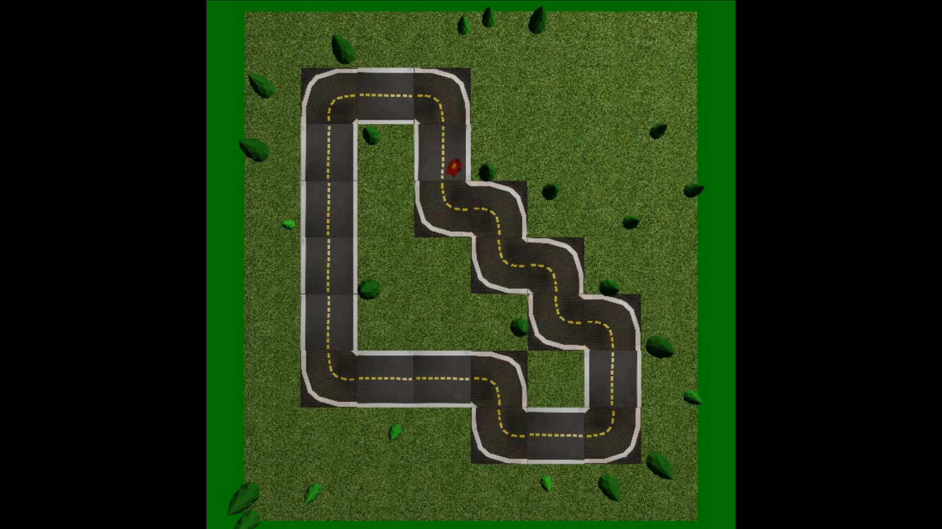
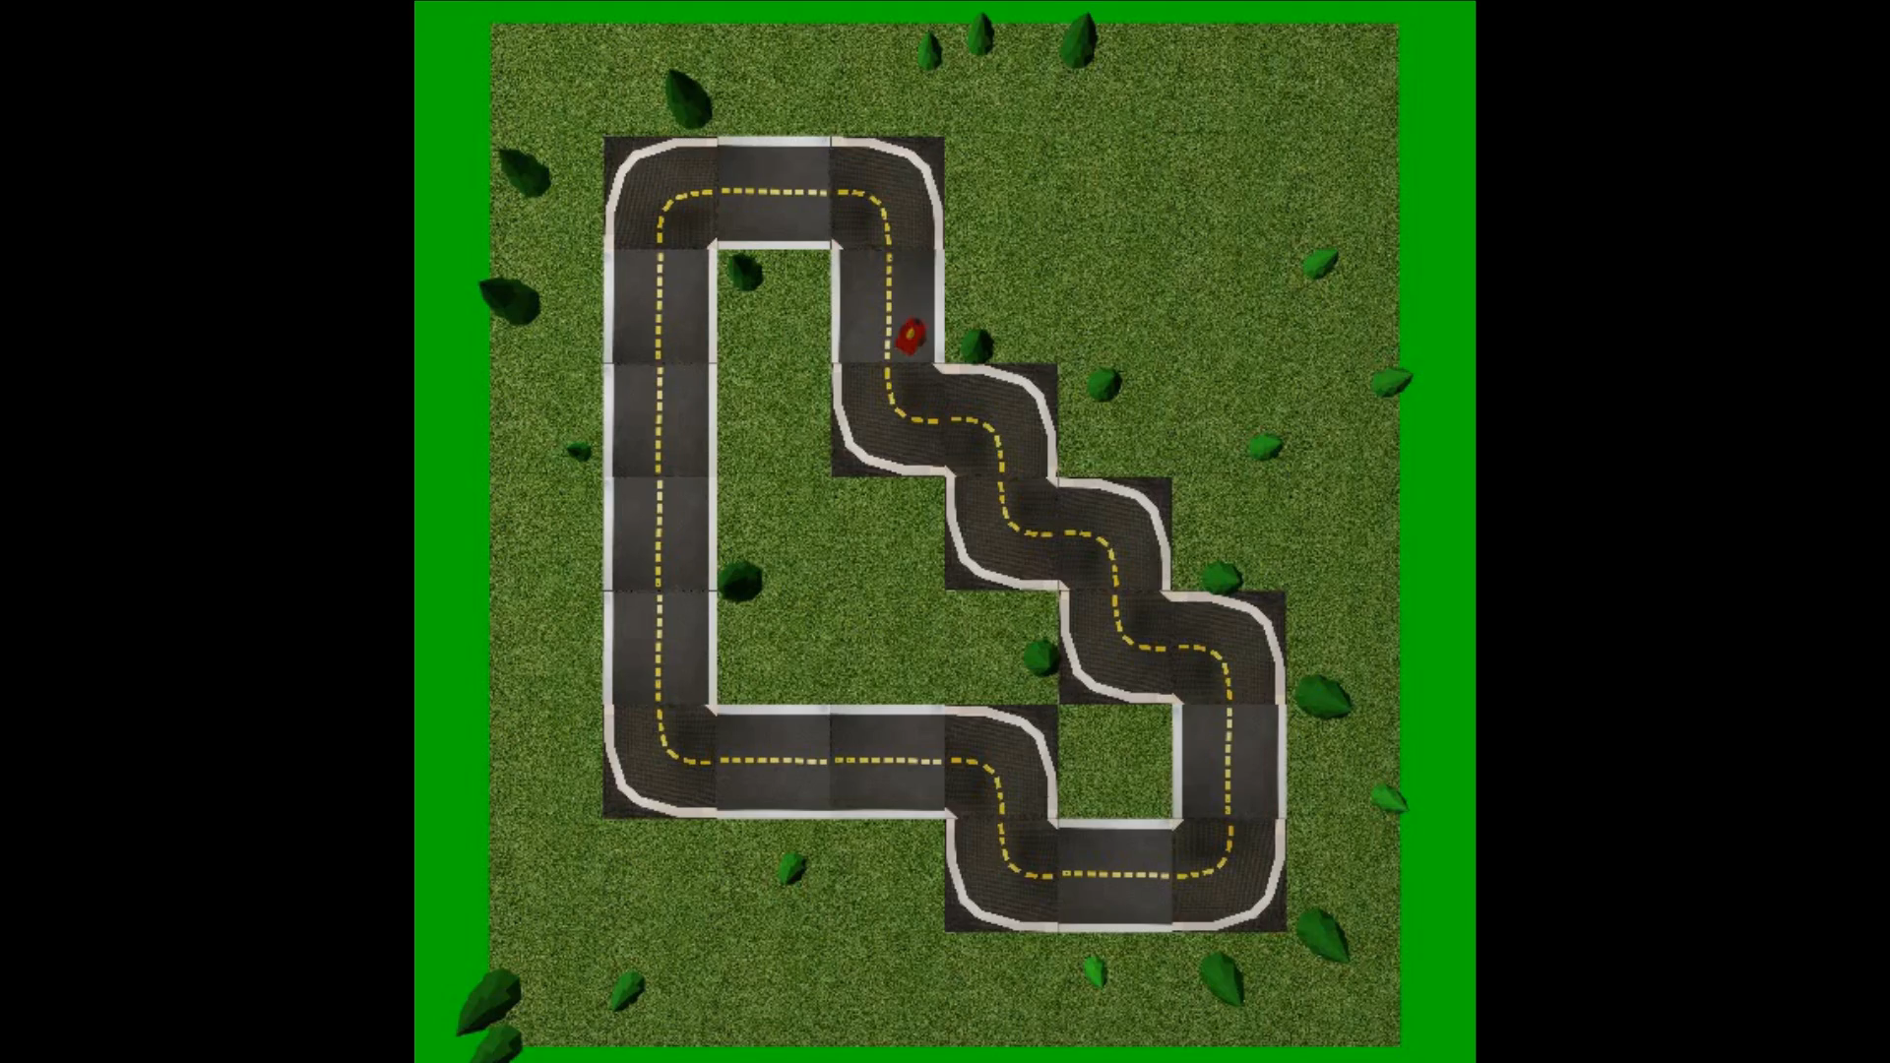
results
Baseline solution:
Our solution:
Metrics | Baseline | Hyperparameter optimised
Driving distance [m] | 10,1 | 12,5
Survival time [s] | 60 | 60
Heading deviation [◦] | 15.14 | 10.46

Slide 11
Conclusion
We used the Dagger algorithm and hypermarameter optimisation to improve the DuckieTown baseline LF solution
Docker image and a cloud based computer with a jupyterlab for the training, testing, evaluating needed much more time than anticipated.
Future plans:
Wider range of parameters for hyperparameter optimisation
Better teacher algorithm
Different neural network architecture

Slide 12
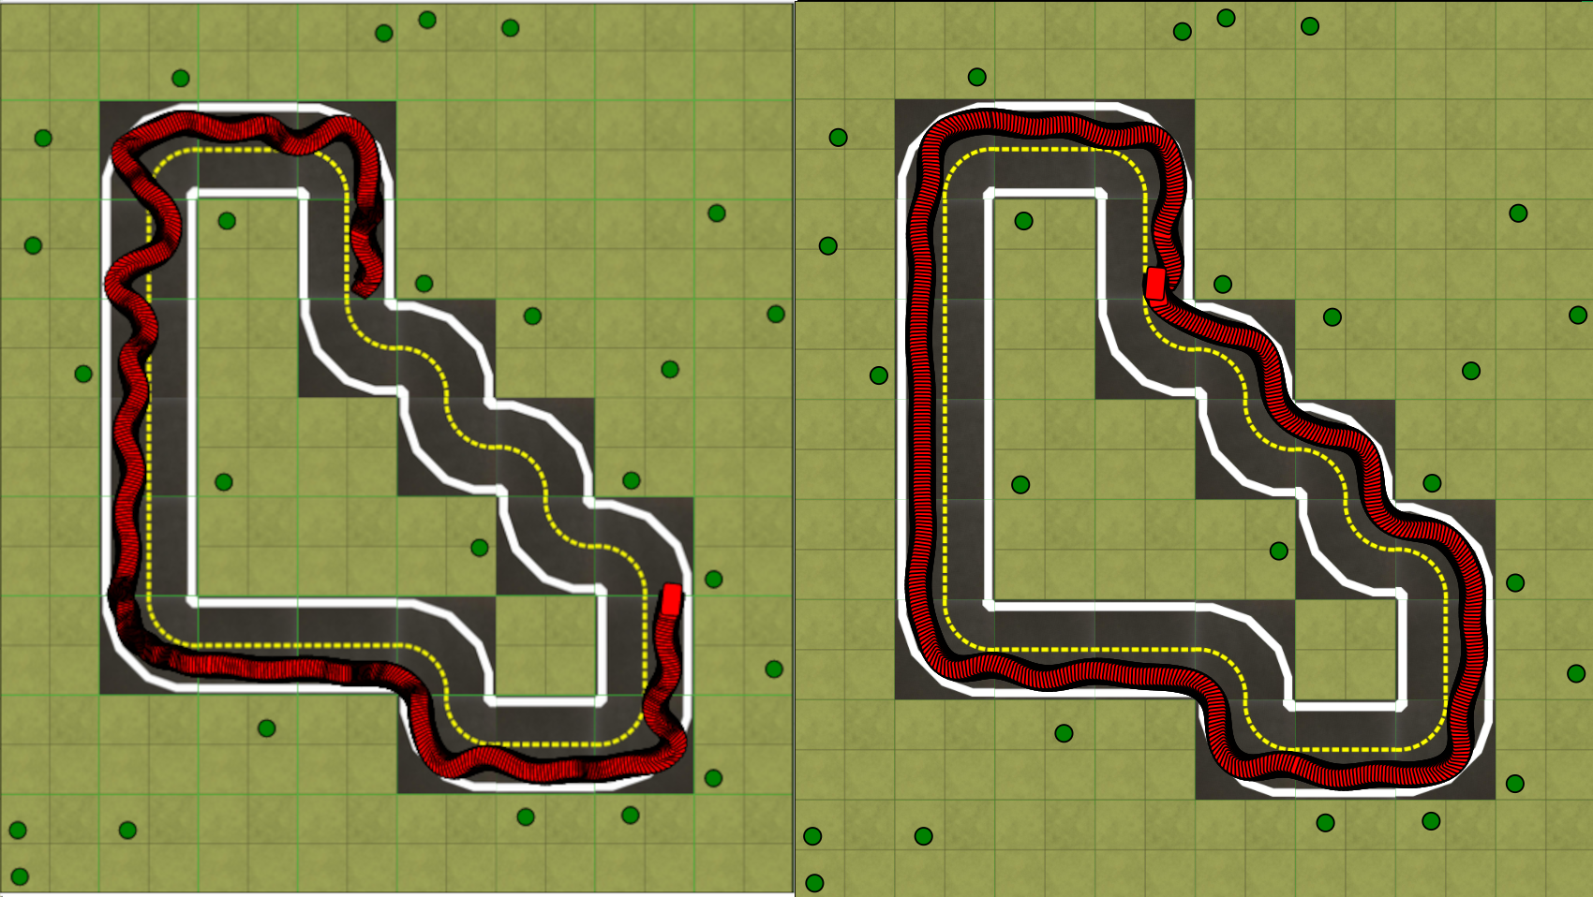
Deepd(r)iveducks
Metrics | Baseline | Hyperparameter optimised
Driving distance [m] | 10,1 | 12,5
Survival time [s] | 60 | 60
Heading deviation [◦] | 15.14 | 10.46
Autonomous driving in the Duckietown environment
Holló Áron
Tóth Tibor Áron
Hajnal Bálint

Slide 13
Thank you for your attention!

